Slide 1
ANNADATA: A Web Based Farmer’s Portal
Group No.14
Kaustubh Sawant | 18104066
Swarad Hajarnis | 18104073
Shubham Khairnar | 18104025
Project Guide Dr.Sameer Nanivadekar
Co-Guide:Prof. Sonal Jain

Slide 2
Contents
Introduction
Objectives
Problem Definition
Technological Stack
Proposed System Architecture/Working
Prototype Design Demonstration
Implementation Status
Status of Paper Draft & Targeted Conference

Slide 3
1. Introduction
Problem Identified -
In today’s world along with ongoing pandemic crises farmer has been facing a lot of issues.
Some of which identified are:- Cope with climate change, biodiversity loss, soil erosion, market prices of crops etc.
Staying resilient against the global economic factor becomes a task for them.
All-in-all there are various sector in which farmer has been facing issues since ages

Slide 4
Solution Proposed:
Addressing the above mentioned issues the , project is designed with an aspect to help farmer in various sectors, Here in, we would be designing a web app that will analyse all the above mentioned conditions and provide them the analysis in simpler and there native language. Till now we have completed below mentioned modules and provided a multi-lingual support to the website.Modules are :
Current Weather Conditions.
Government Schemes
Farm Bills
Soil and Water Conservation
Farmer Corner
Equipment Shops
Crop Prediction

Slide 5
2. Objectives
To provide a multi-lingual support to the portal.
To notify the farmers about the red flags in weather forecasting.
To make them aware about the different Govt. Schemes that are beneficial to them and notify them everytime the government launches a new scheme.
A prediction system that would help farmers about the best yielding practices.

Slide 6
3. Problem Definition
India can be addressed as an agricultural state as much of the country’s export products
are from the agricultural domain. Thereby, it becomes necessary to address the issues faced
by the people associated with this domain. It becomes necessary to provide them with the
products that can be useful for them and they can find information related to many sectors in
their domain at one place.

Slide 7
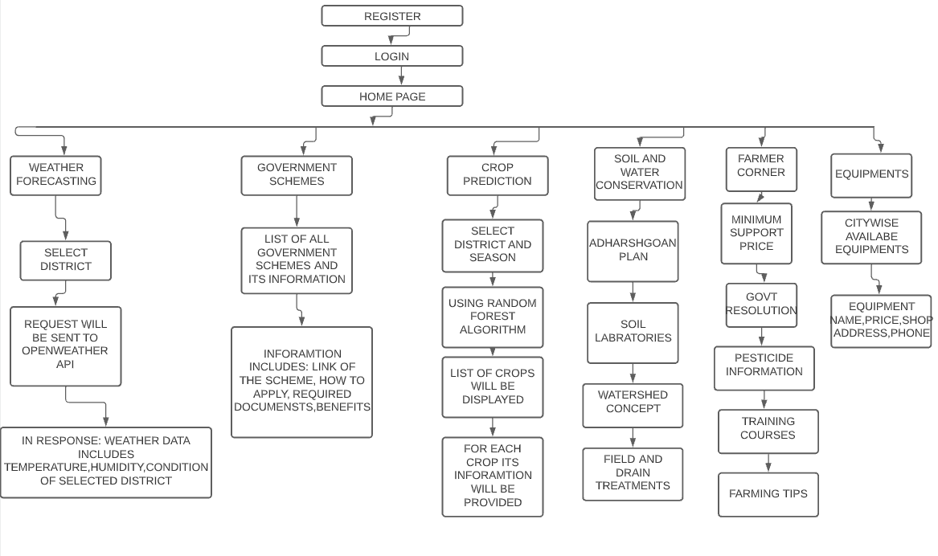
4. Proposed System Architecture/ Working

Slide 8
5. Technological Stack
Django
SQL
Random Forest Regression

Slide 9
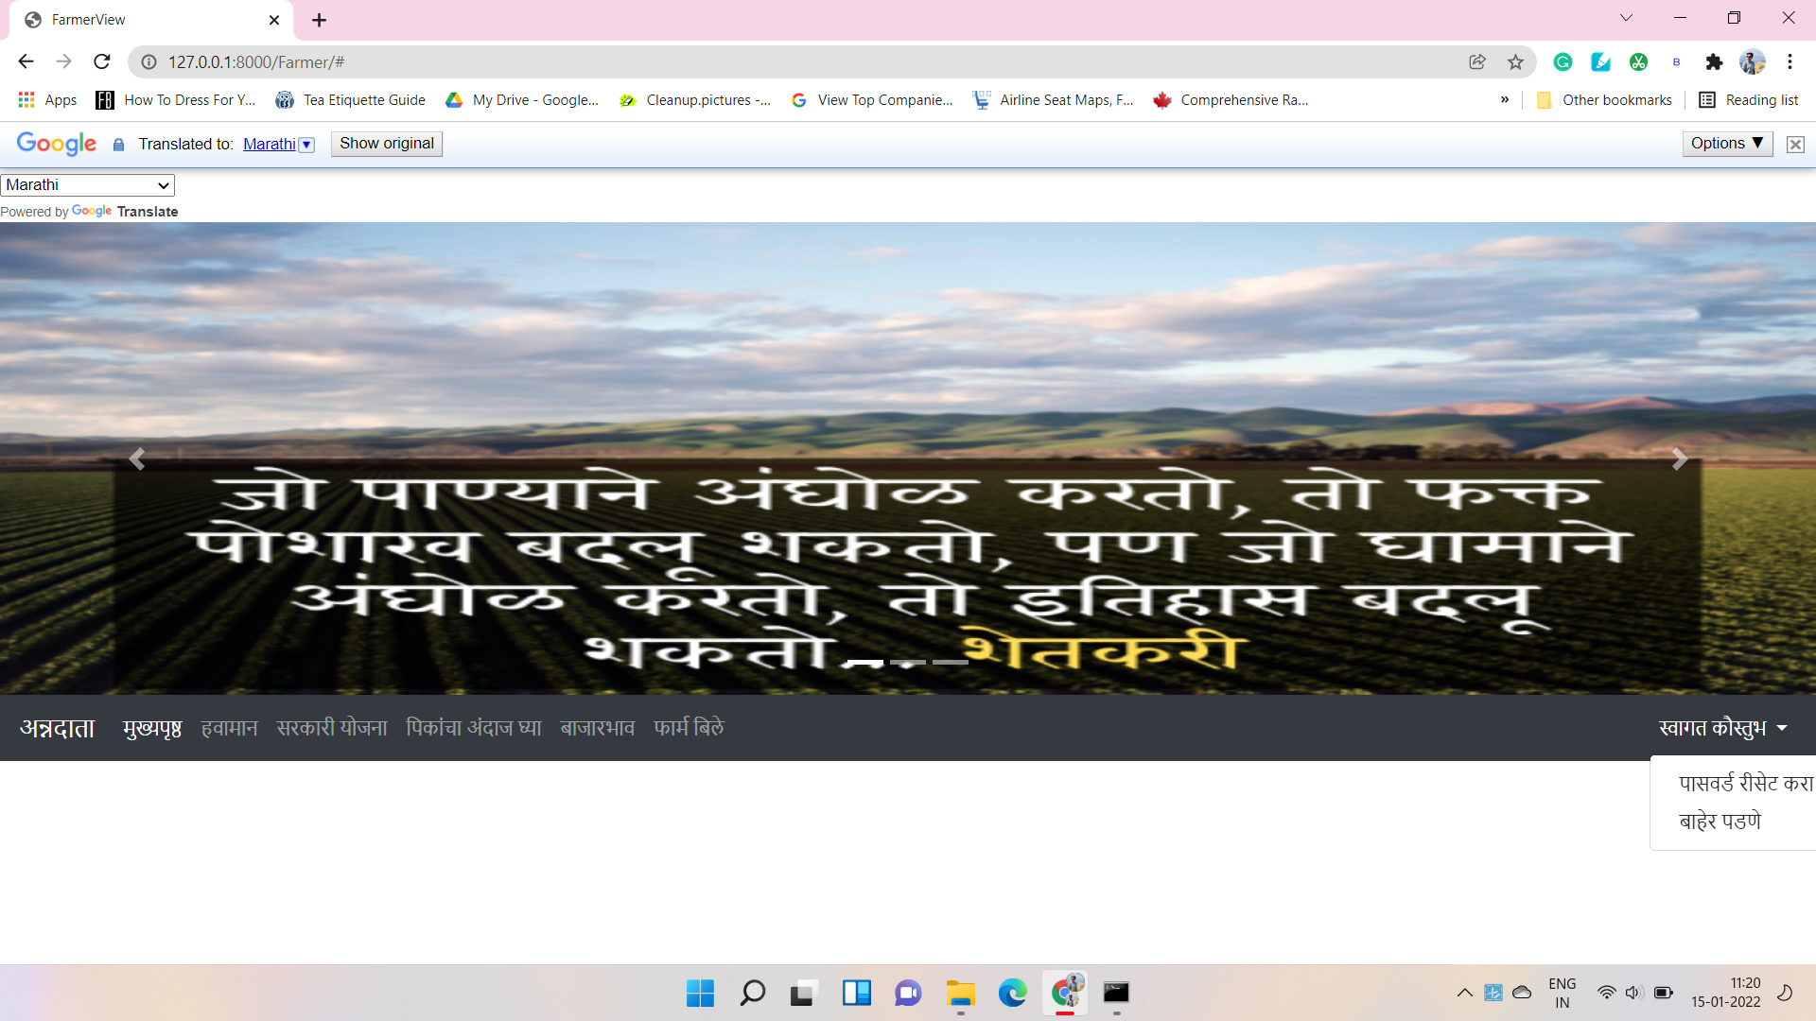
6. Prototype Design Demonstration

Slide 10
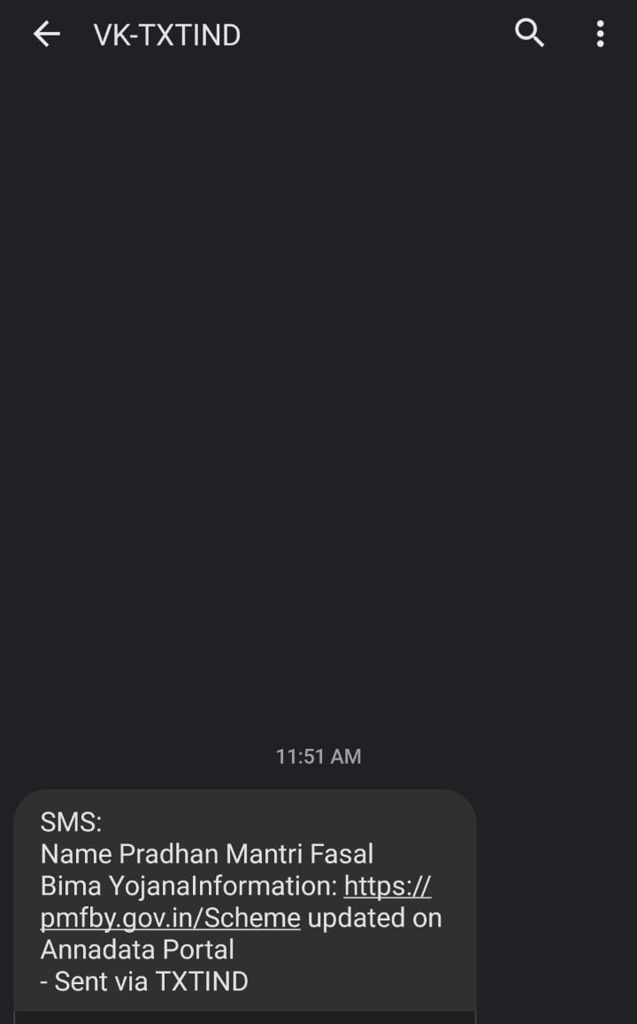

Slide 11
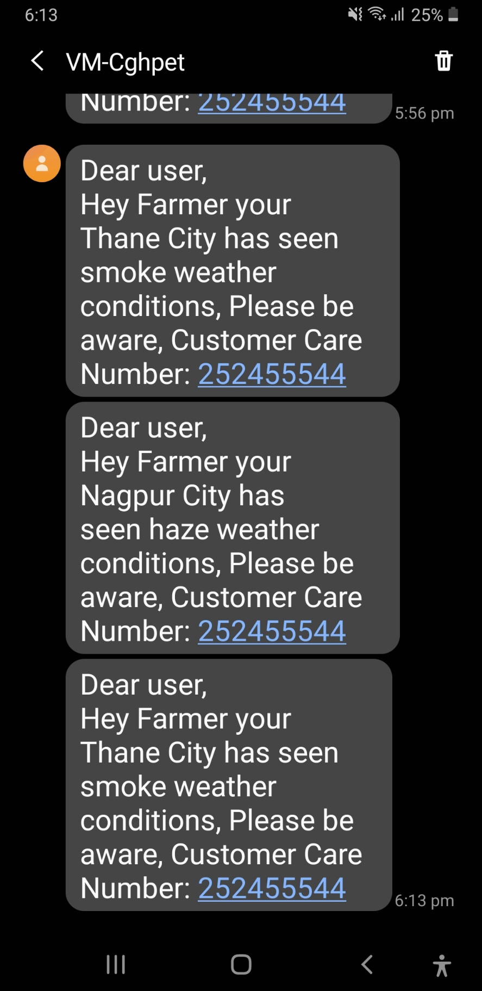

Slide 12
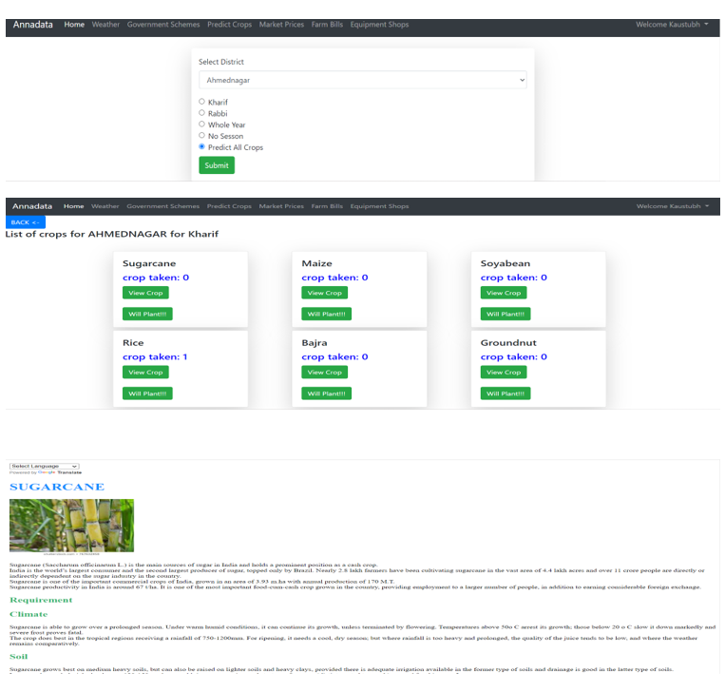

Slide 13
7. Implementation Status
Completed all the modules and objectives.

Slide 14
8. Status of paper draft and targeted conference
1. Paper is has been accepted by ICTIS(Springer)

Slide 15
Thank You...!!

